Slide 1
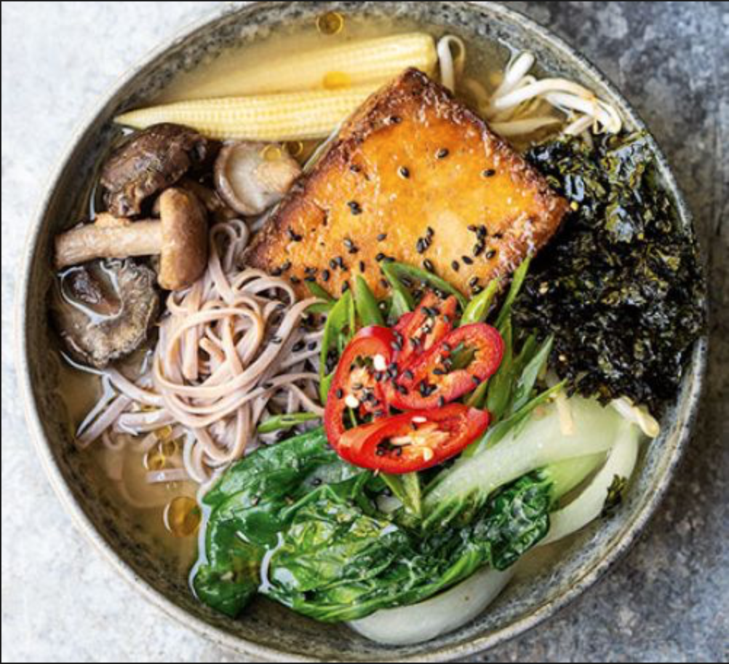
https://www.dropbox.com/s/4bbzgkpzorbain9/Screenshot%202019-04-09%2016.47.49.png?dl=0
GOOD FOOD
Shiqing Liu
Patricia Arnal Luna
FINAL PROJECT
May 6th, 2019
Computer Science 1.001

Slide 2
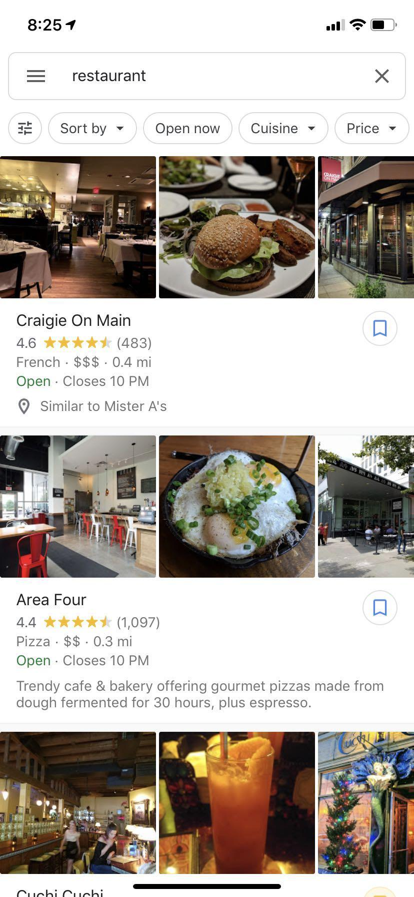
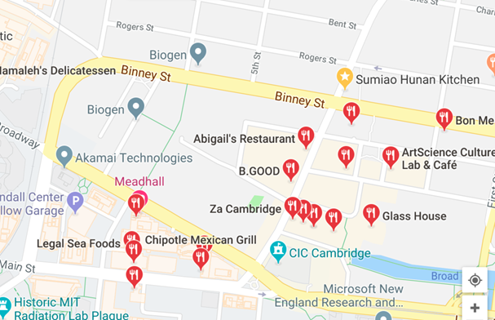
Problem of Restaurant Searching
Takes time to go back and forth between Google Maps and each restaurants reviews to to match the eatery with the localization. Currently you can see plenty of restaurants nearby without knowing if they are any good, how reliable their ratings are or the kind of food they serve.

Slide 3

Find your Tacos, Fast.
Why do we do this? To save people time and frustration. Low battery? Time crunch?
So how is Good Food better? It DISPLAYS in ONE SCREEN, 4 useful functions.
Function 1: Reviews as the size of the icon, how many people have rated.
Function 2: Quality of the food, in terms of Stars from 1 to 5; as the intensity of the color. The more intense the color the better the food.
Function 3: Food Icons are intuitive graphics of actual food, moreover, when hovering over the icon, the variety of foods served is displayed.
Function 4: Check-in time is shown, not only open hours, so you know it’s open, if someone just walked in!

Slide 4
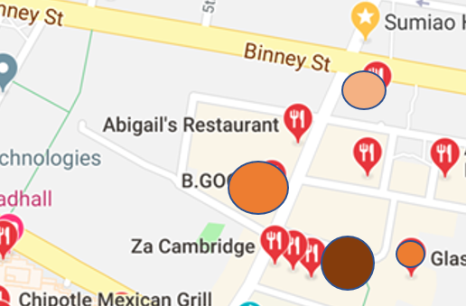
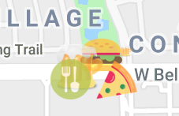
AIMED:
Size of the circle = Number of reviews.
More reviews means larger circle.
Intensity of color = Ratings
Brighter means higher rating.
ACCOMPLISHED:
Size = Number of reviews.
More reviews means larger size.
Intensity = Ratings
1 to 5 Stars shown as brighter color.
FOOD ICON = Much more intuitive!

Slide 5
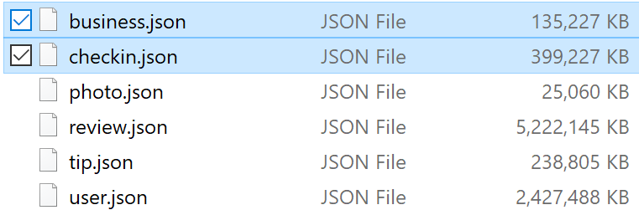
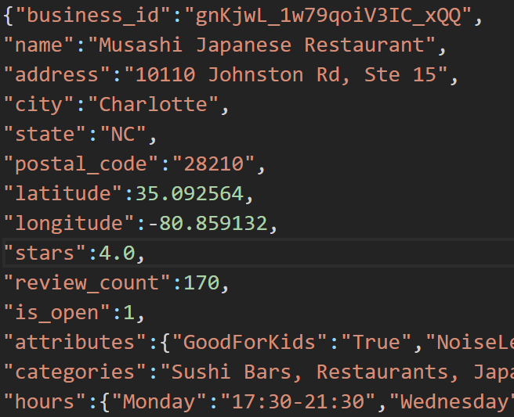
Original Data
Data is downloaded from Yelp
Business and Checkin data are used in our project
Business data:
Business_id,
Name
Address
City
Zip code
Lat & Lng
Stars
Review-Count
Categories
Check-in Data:
Business_id
Check-in date&time
https://www.yelp.com/dataset
Notes:
What is checkin.data

Slide 6
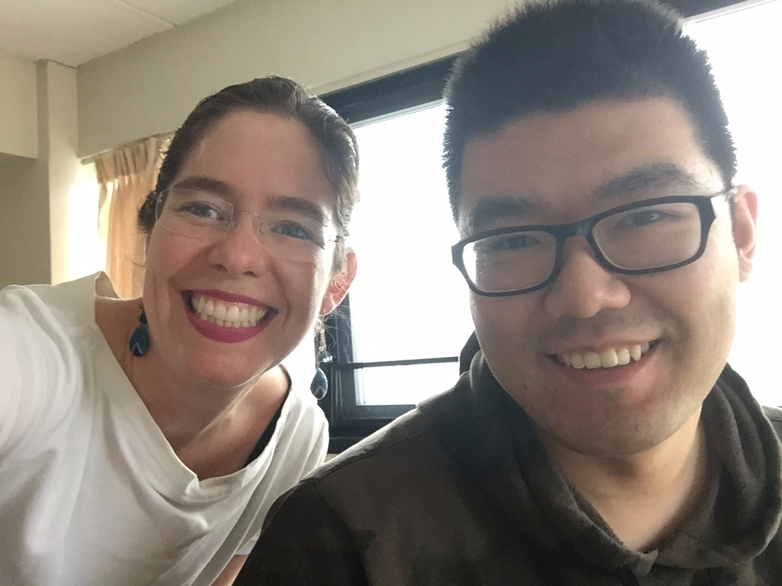
Check-in Data Filtering
Smaller files, so
our computers
wouldn’t crash :D
Only keep the latest check-in time for each business
Checkin.json
399 MB
161950 lines
{“Business_id”:”xxx”,”Date”:”xxx,xxx,xxx...”}
Checkin_last.js
13 MB
161950 lines
{“Business_id”:”xxx”,”latest_checkin_time”:”xxx”}
Find latest Time by Checkin_filter.js

Slide 7
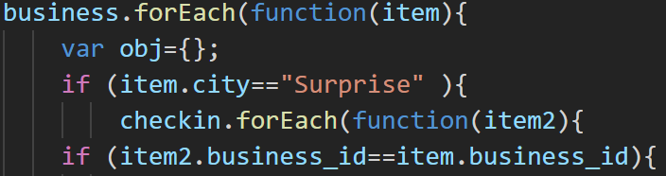
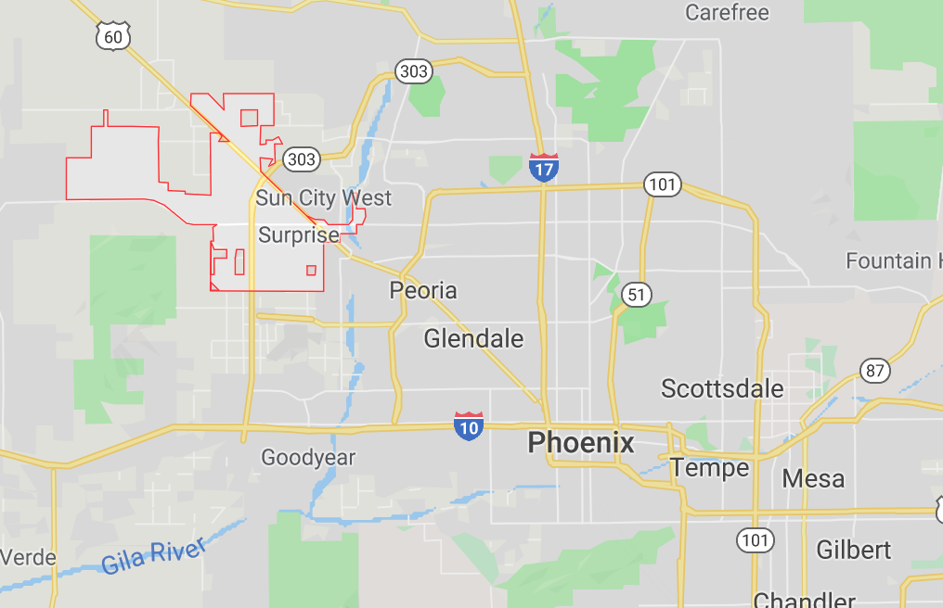
Business Data Filtering and Merging
Merge with latest check-in data by checking business_id
Filter business data by City
City: Surprise, Arizona
Business_Surpirse.js
924 businesses
Business_id,
last_checkin_time,
Zip code,
star,
review_count,
Lat & lng,
categories

Slide 8
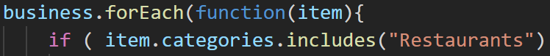


Restaurants Filtering
Filter business data and keep restaurants only
Search if business_Surprise.Categories includes word “Restaurants”
Find Restaurants by filter_restaurants.js
Restaurants_Surpirse.js
224 Restaurants
Business_Surpirse.js
924 businesses
"categories":"Health & Medical, Internal Medicine, Doctors"
"categories":"Sandwiches, Fast Food, Restaurants"

Slide 9
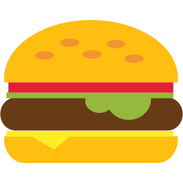
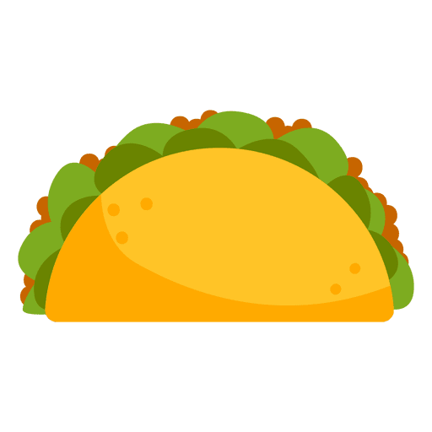




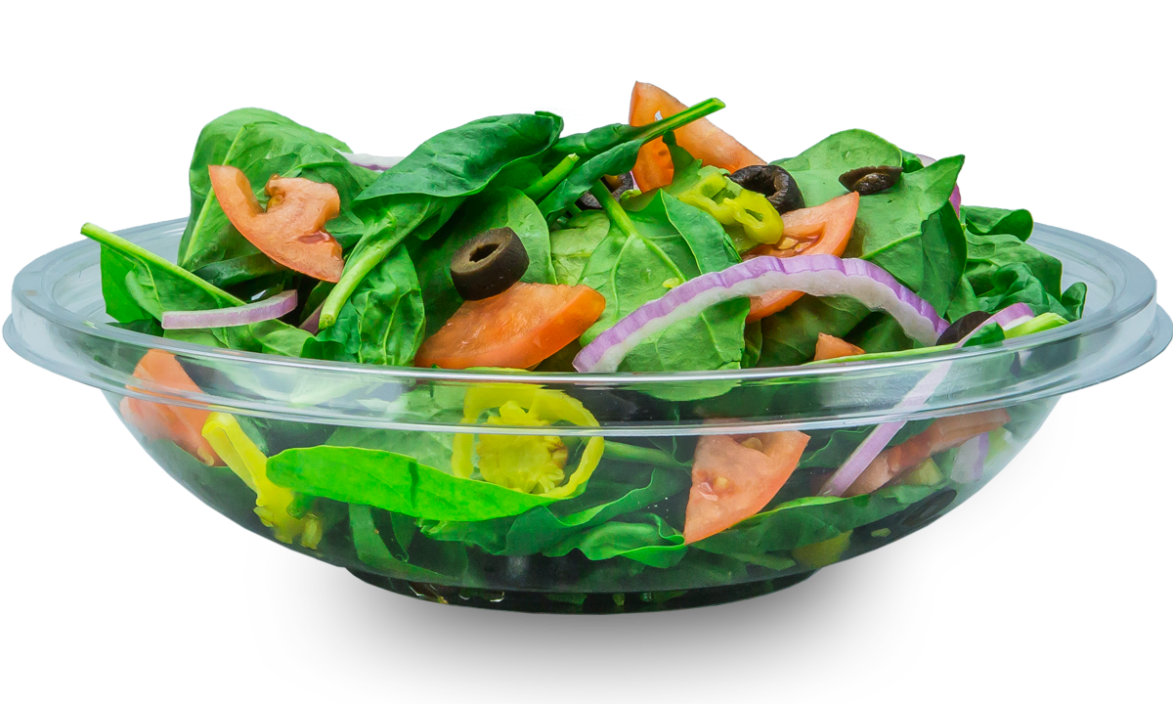



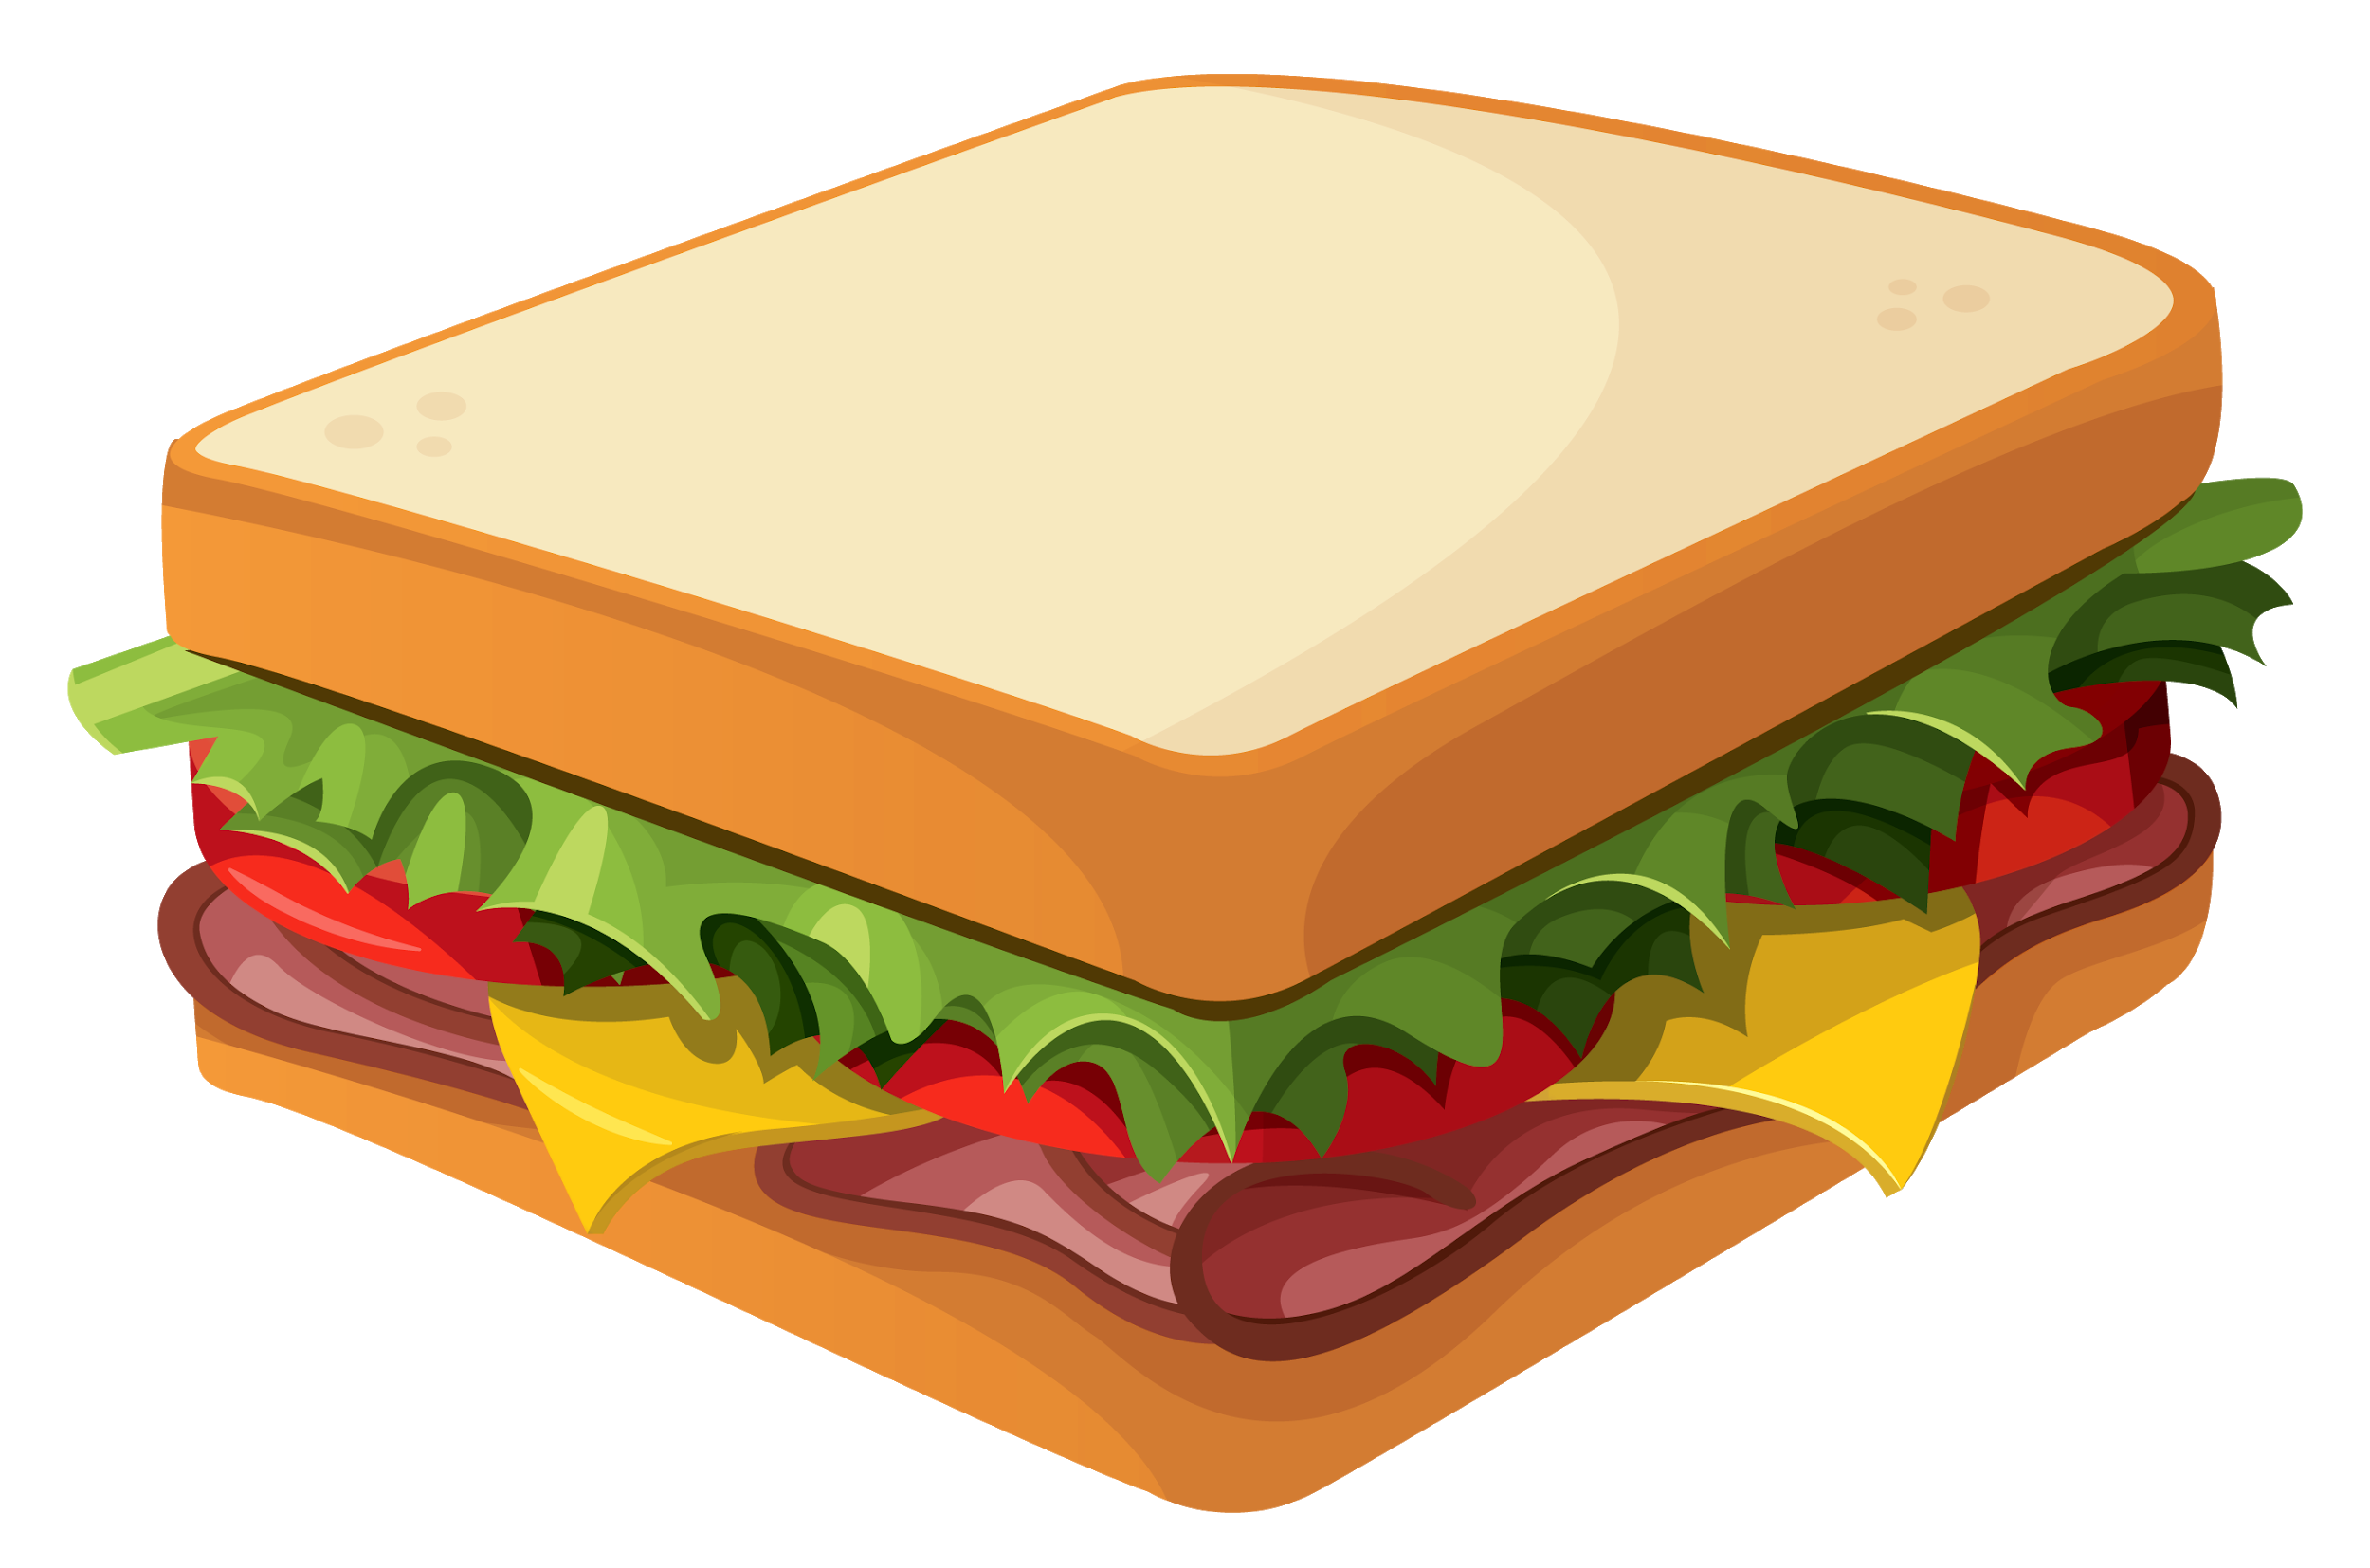
What is your favorite food?
Define restaurant type by
Searching:
“Burgers”, “Pizza”, “Sushi”,...
in restaurant.categories
Display corresponding Food Icons on map

Slide 10
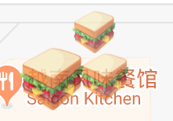


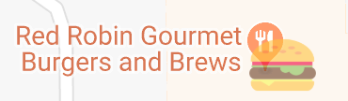
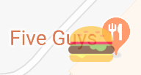
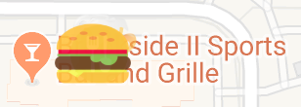
Is a Restaurant Good?
61
Number of reviews: Size of the icon
Large icon = more reviews = more popular
Reviews count range: 4 - 462
Size = log(review_count)*7
462
104
Star:
1.5
2.5
3
3.5
4.5
Star: Opacity of the icon
Star: 1-5, Opacity: 0-1
Opacity = restaurant star/5

Slide 11
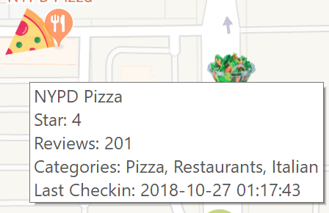
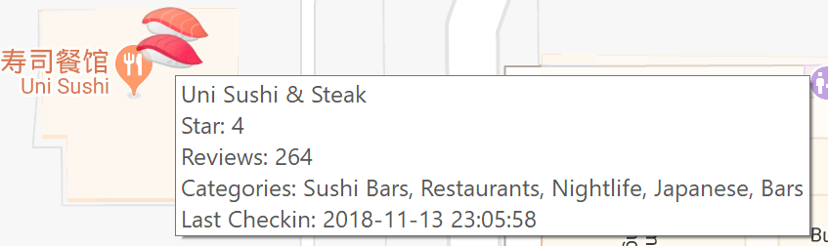
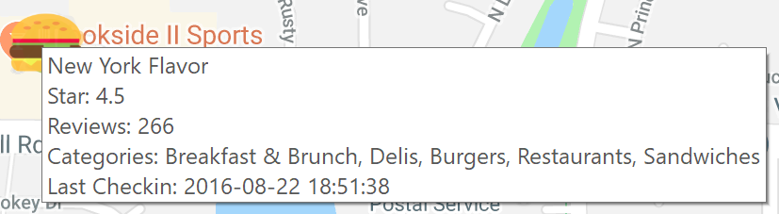
More Restaurant Information
More information will display when hover your mouse on a restaurant
Last check-in time tells when the restaurant was visited and checked in.
If a restaurant was not checked in for a while, it may be closed.

Slide 12
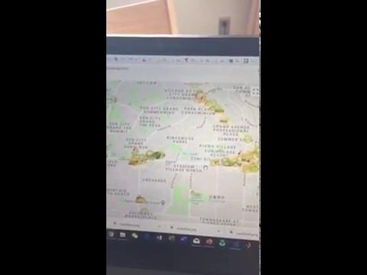
In the making…
3 of 3
May the 4th be with you!
...and Good Food too!
https://youtu.be/rANP1tbaj0A

Slide 13
https://www.dropbox.com/s/4bbzgkpzorbain9/Screenshot%202019-04-09%2016.47.49.png?dl=0
Thank You
Q&A
Shiqing Liu
Patricia Arnal Luna
May 6th, 2019

Slide 14
Bloopers

Slide 15
Like that time when were moving to Sunrise City...
Because all it had were BARS.
Until we realized there where SUSHI Bars, Ice-cream Bars, BARbeques…
Solution -> Our prioritization changed: Sushi HAD to go before Bar and then we stopped looking for BAR, and went for BARS.

Slide 16

11 TOP Food Apps.
NONE show food icons: https://urbantastebud.com/11-best-apps-every-foodie-must-have-on-their-phone/
TripAdvisor (Ratings -if you have the time…), Foursquare (Ratings), OpenTable (reservations), Acorns, Chefsfeed, Grubhub, ForkIt, Starbucks App…
From there on, they are all brand oriented, not consumer oriented.

